Slide 1
Welcome!

Slide 2
How to Schedule a Post on Your Auxiliary Facebook Page

Slide 3
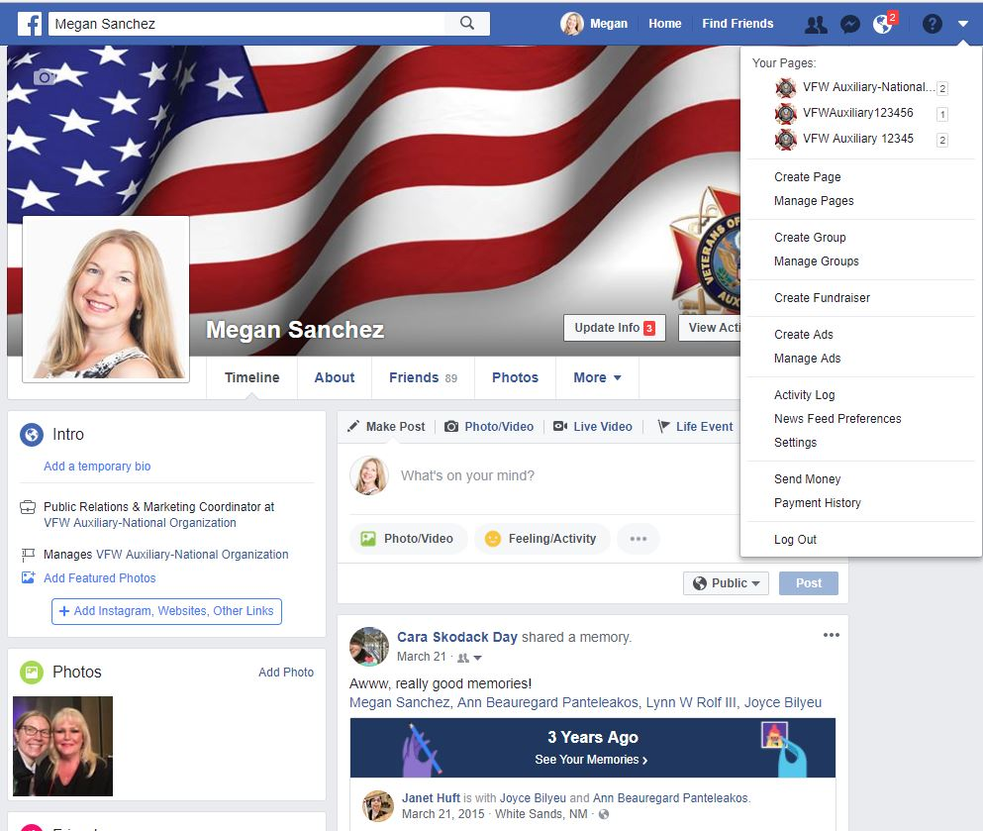
To post as your Auxiliary, go to your Personal Profile Page and select the UPSIDE DOWN TRIANGLE at the top of the page.
A drop down menu will display.
Under “Your Pages,” select your Auxiliary. (i.e. VFW Auxiliary 12345)

Slide 4
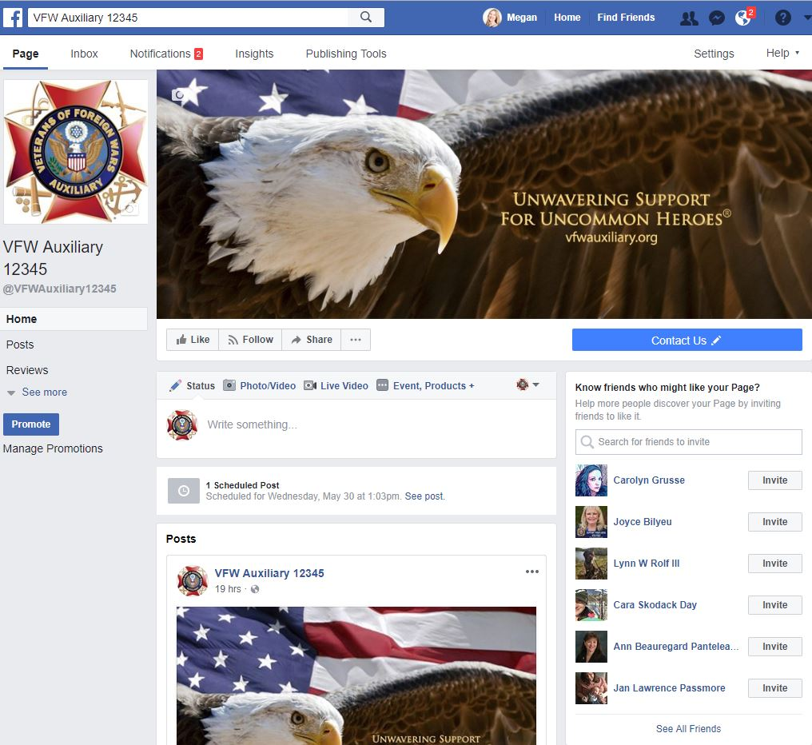
Once you’ve switched to use Facebook as your Auxiliary, your Auxiliary page will display.

Slide 5
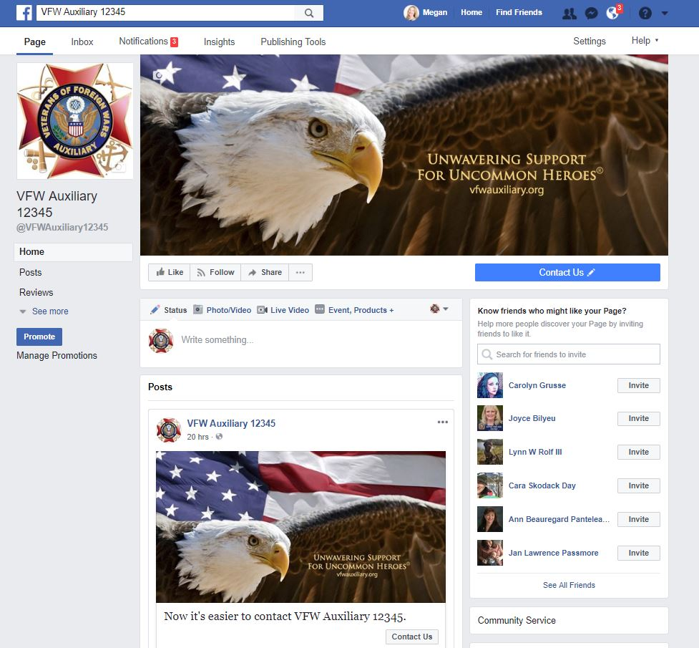
Now you’re ready to post to your Auxiliary page!
Click in the box where it says “Write something…” to type the post.

Slide 6
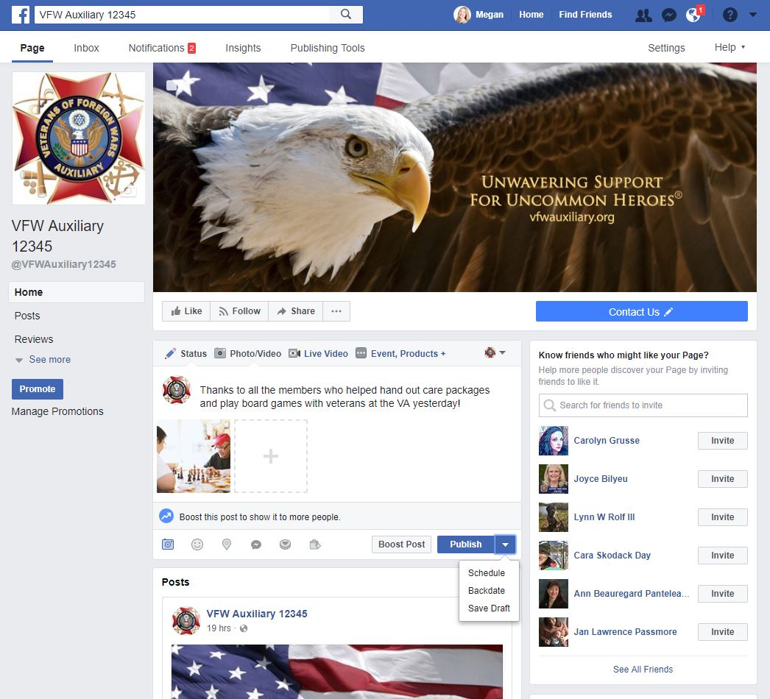
Type a post and add a photo to the post just as if you were going to publish it immediately.
Instead of clicking “Publish”, click the UPSIDE-DOWN TRIANGLE next to “Publish” in the lower right-hand corner of the status update box.

Slide 7
Next, select “Schedule.”

Slide 8
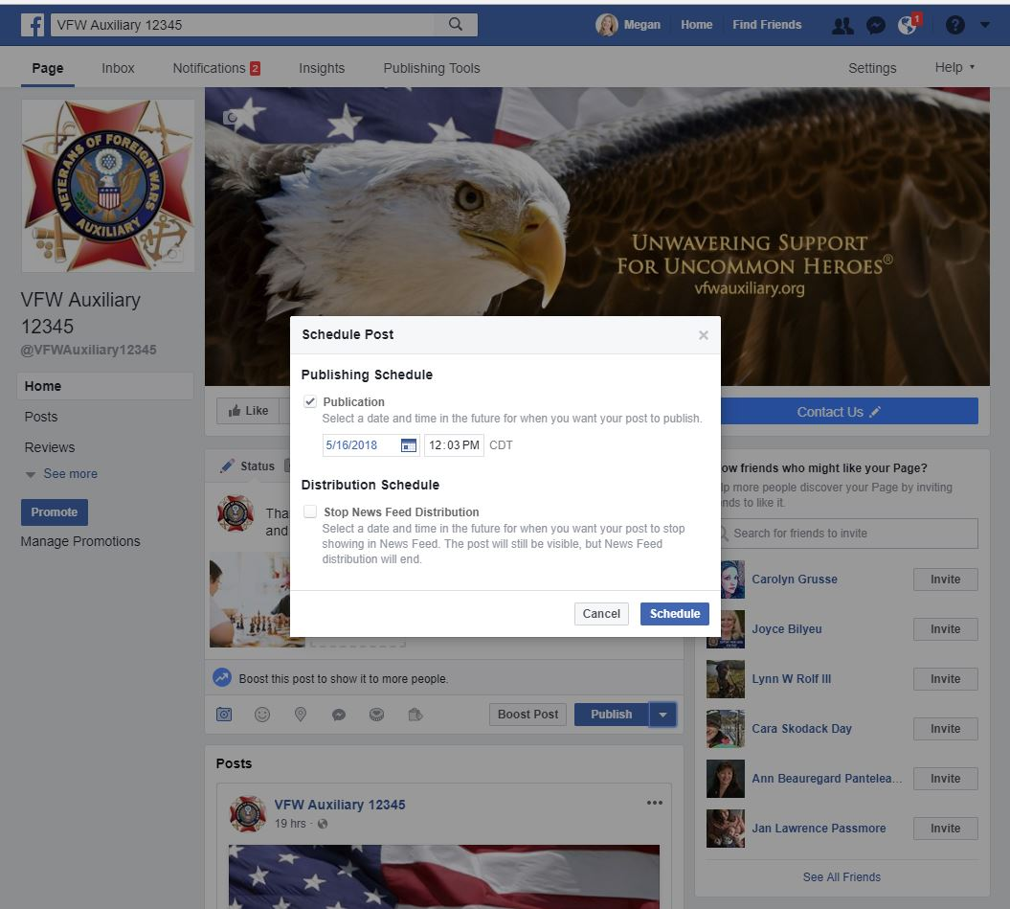
The “Schedule Post” pop-up box will display.

Slide 9
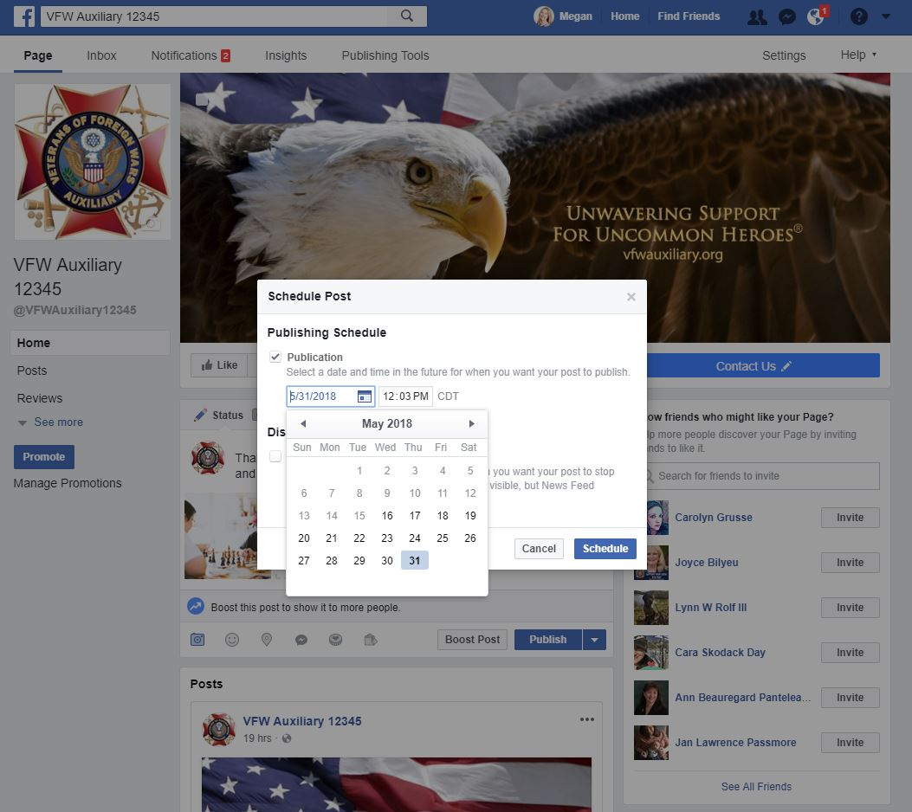
Click on the DATE you would like your message to post.
Tip: You can change the month by selecting the arrows on either side of the month and year.

Slide 10
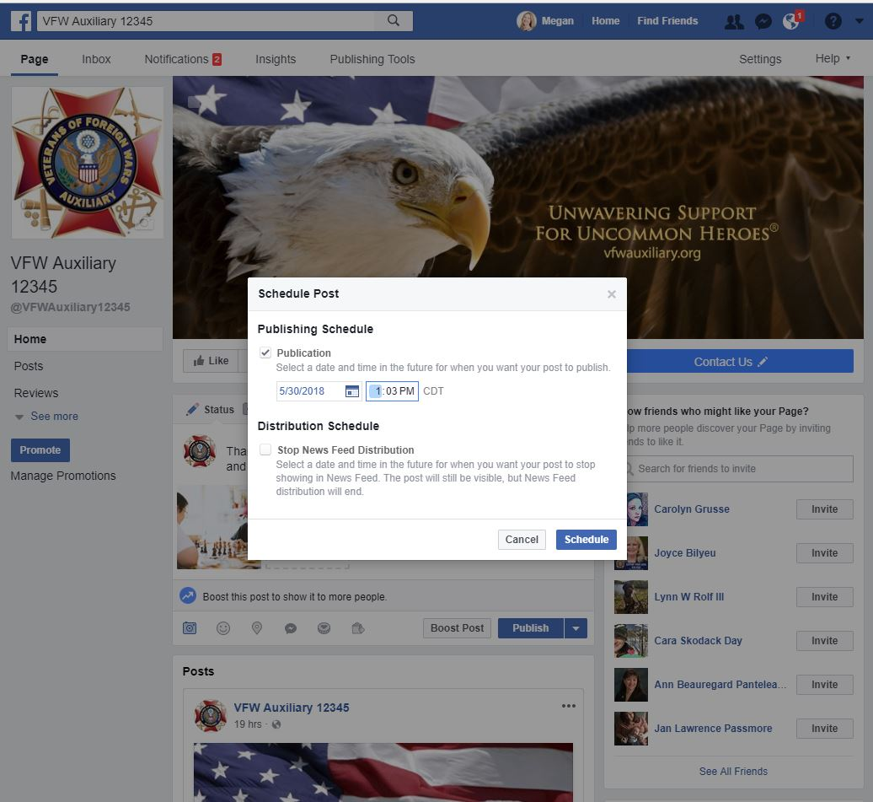
Next, select the TIME you would like the post to publish to your Auxiliary or Facebook Page by clicking in the time box.
Tip: Make sure you look at whether the time is AM or PM!
Once the date and time is selected, click the “Schedule” button.

Slide 11
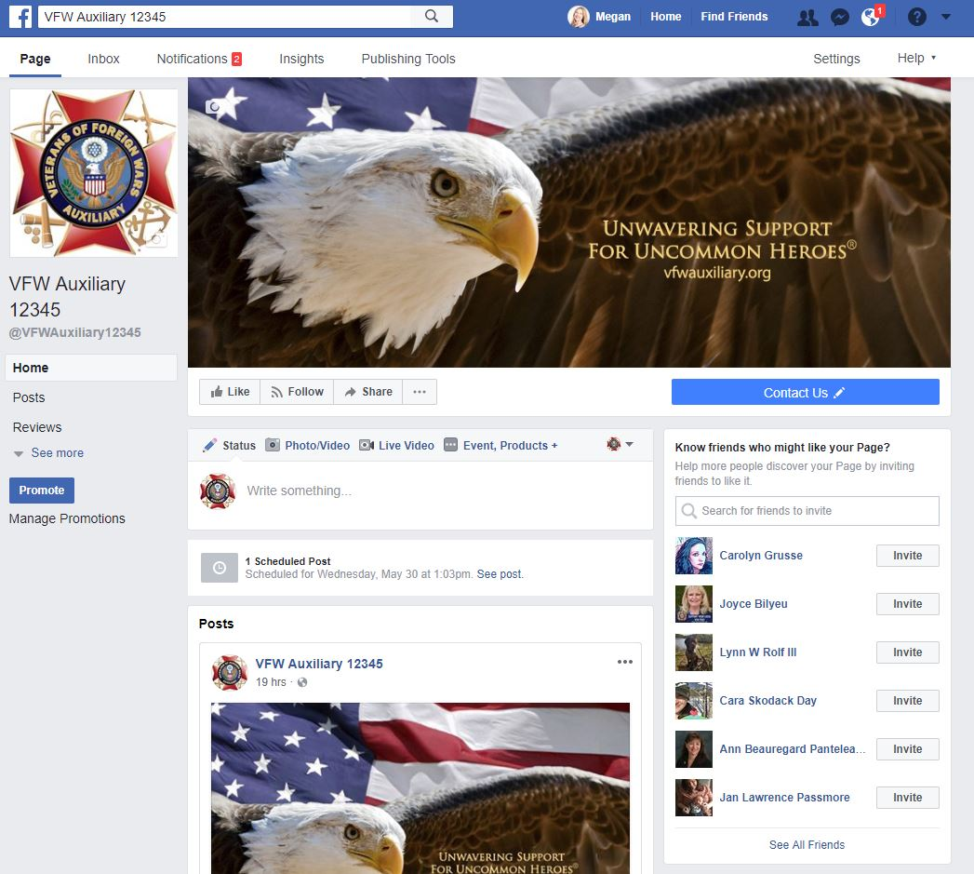
You will receive confirmation that your post is scheduled.
To view all scheduled posts, click “See Posts.”

Slide 12
Questions?
Contact Megan Zinn-Sanchez
Public Relations & Marketing Coordinator
VFW Auxiliary National Headquarters
mzinn-sanchez@vfwauxiliary.org

